Slide 1
Midterm Review
Team 6 - Tianjie Zhu, Keming Wu, Rus Thomas, Griffin Gilder

Slide 2
Table of contents
01
02
03
04
Concept Review
Code Review
Concept review on Ch6-8.1
Main functions regarding algorithms on Ch6-8.1
Exercise
Kahoot
From Ch7.9
Game Time!

Slide 3
01
Concept Review
From Chapter 6 to 8.1

Slide 4
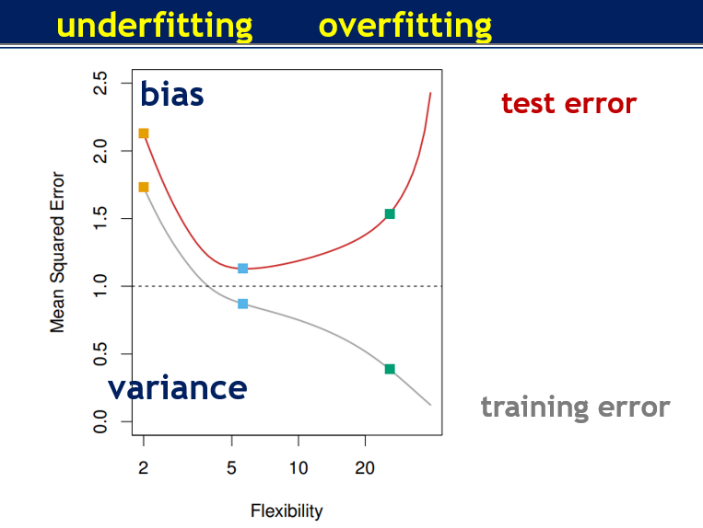
CH6 Feature Selection (Linear setting)
Purpose
Want the model with best training (bias) and testing error (variance) → solve overfitting issues
Subset selection
Best subset selection
Stepwise selection
Forward
Backward
Shrinkage and regularization
Lasso (L1) regression
Ridge (L2) regression
Elastic - Net
Dimension Reduction
PCA
PLS

Slide 5
Subset selection
Best subset selection
Fit a least square regression for every combination of p features (2^p models) based on cross validation measures (adjusted R^2, AIC, BIC, etc.)
Pros: easy to understand
Cons: computationally intense
Stepwise selection
Forward: start from 0 features, add one feature at a time
Final selected model is not always the best
Backward: start from all features, delete one at a time
Doesn’t work when n<p
library(leap)
regsubsets(Y~X, data, nvmax=19,method = ‘forward’)

Slide 6
Shrinkage
Purpose
Reduce variance (but increase bias)
Ridge (L2)
Minimize RSS+ β *slope^2
shrink β coefficient towards 0 (not 0)
introduce a small amount of bias to the training data —> decrease variance
Lasso (L1)
Minimize RSS+ β *|slope|
shrink β coefficient towards 0 (allow 0)
Ridge vs. Lasso
use L2 when most features are useful
use L1 when the model includes lots of useless features
L1 can be used to reduce dimensions
Elastic-Net
Lasso + Ridge
useful for shrinking multicollinearity
library(glmnet)
glmnet(x, y, alpha=1/0, lambda=)

Slide 7
Dimension Reduction
Main idea:
Projecting p features into a M dimensional subspace, where M<p
PCA (unsupervised)
Without y
Steps:
Center data
Fit line through the origin
Measure fit with projection
Min SS(distance from data point to projected point)
Max SS(distance from projected point to origin) → PCA
PLS (Supervised)
With y
Can reduce bias but increase variance
pcr(Y~X, data, scale=TRUE, ncomp =7, validation=“CV”)
plsr(Y~X, data, subset=train, scale=TRUE, validation=“CV”)

Slide 8
CH7 Non-linear Models
Purpose: Use non-linear models to predict while maintaining interpretability
Polynomial Regression:
Extends the linear model by adding extra predictors
Step Functions:
Cut the range of a variable into K distinct regions to produce a qualitative variable
Regression Splines:
Extension of both polynomial regression and step functions
Smoothing Splines:
Minimize a residual sum of squares criterion subject to a smoothness penalty

Slide 9
CH7
Purpose: Use non-linear models to predict while maintaining interpretability
Local Regression:
Similar to splines, but the regions are allowed to overlap
Generalized Additive Models (GAM):
Allow us to extend the other methods to deal with multiple predictors
Linear vs. Non-Linear Regression:
Non-linear methods are more flexible

Slide 10
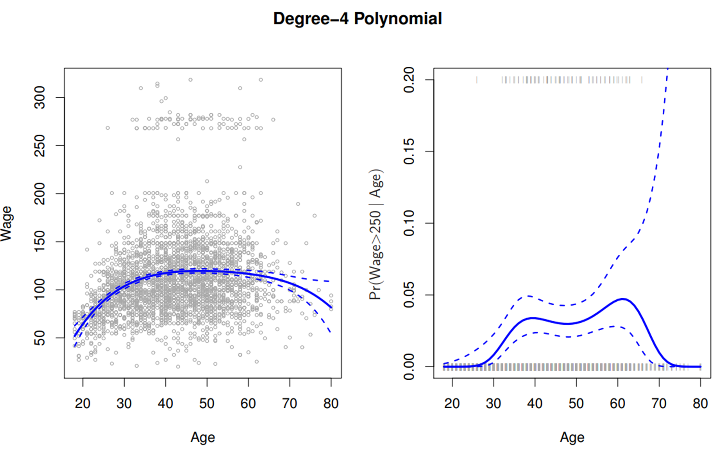
Polynomial Regression
Notes:
Add polynomial terms to the X variable
Generally speaking, more than 4 polynomial terms is not optimal as the curve becomes overly flexible (especially near the tail of the X variable)
R Options for Creating Polynomial Terms:
poly(X,4)
Orthogonal
X + I(X^2) + I(X^3) + I(X^4)
Not orthogonal
cbind(X, X^2, X^3, X^4)
Not orthogonal

Slide 11
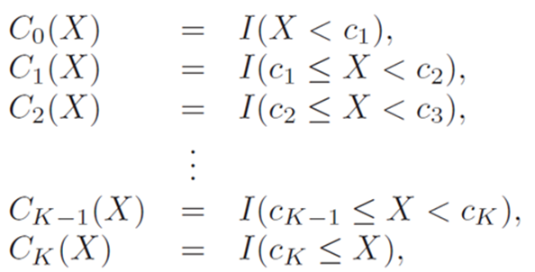
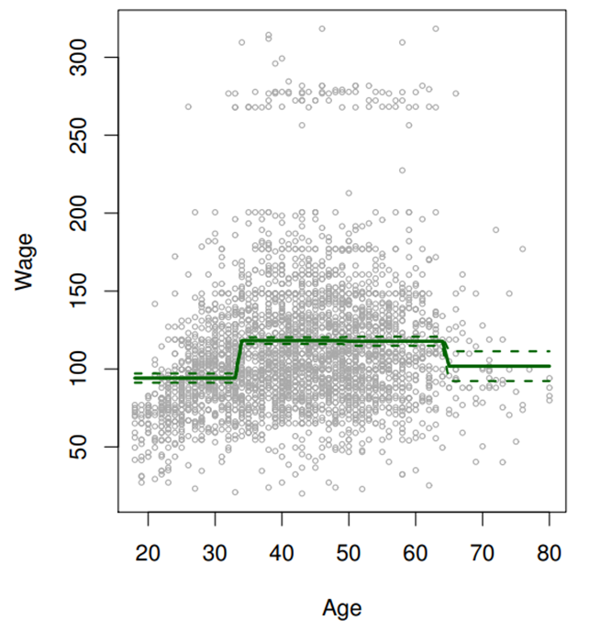
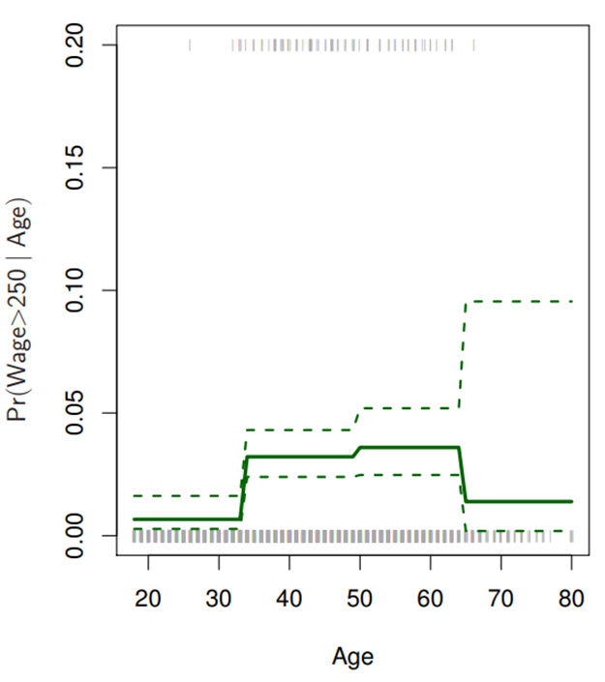
Step Functions
Notes:
Step functions allow us to avoid a global structure by separating the range of X into bins and fitting a constant to each bin
We are essentially converting a continuous variable into an ordered categorical variable
Useful in the case of natural breakpoints in the range of X
The left figure below is fitted step regression, and the right is fitted logistic regression

Slide 12
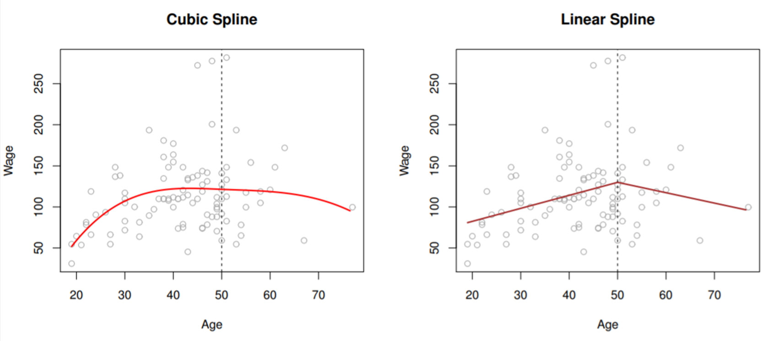
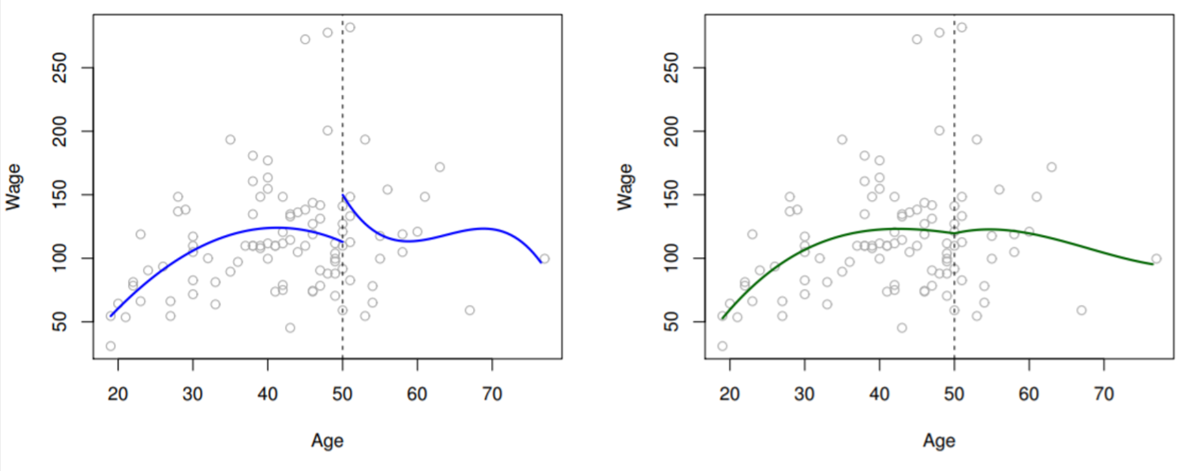
Regression Splines
Note:
A flexible class of basis function that involves fitting separate low-degree polynomials over different regions of X
Unconstrained Constrained

Slide 13
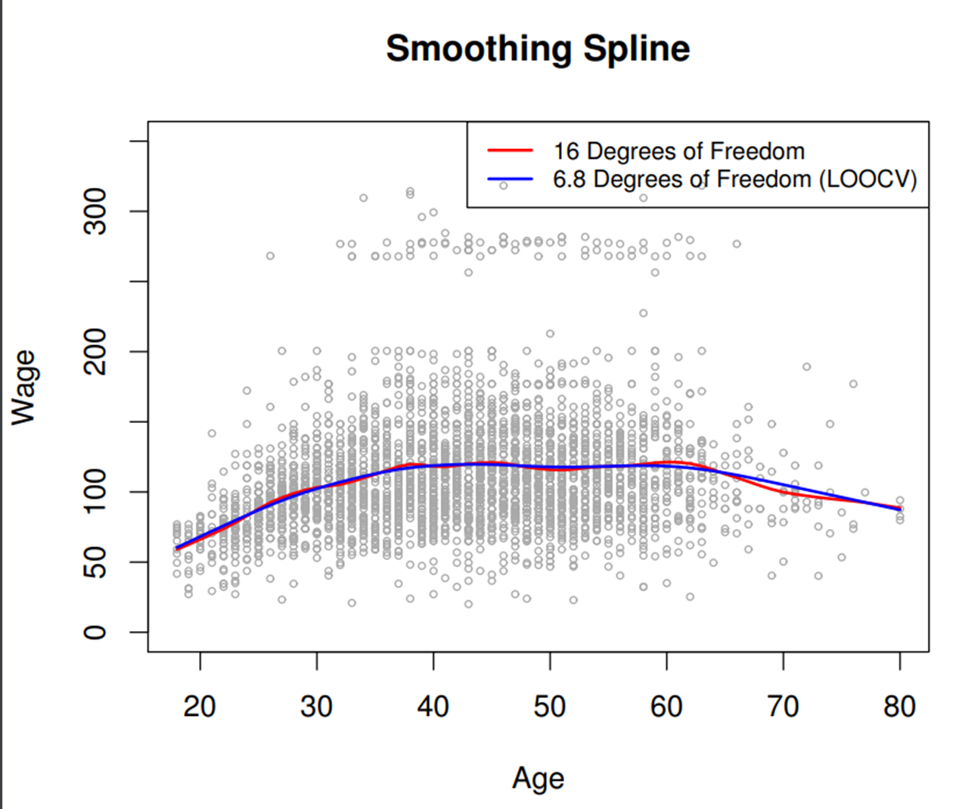
Smoothing Splines
Notes:
Can achieve perfect fit (RSS = 0) by going through every data point
Therefore, this model is by default overfit
We should prevent this by programming a smooth model
Minimize the second derivative (change in slope) in the function

Slide 14
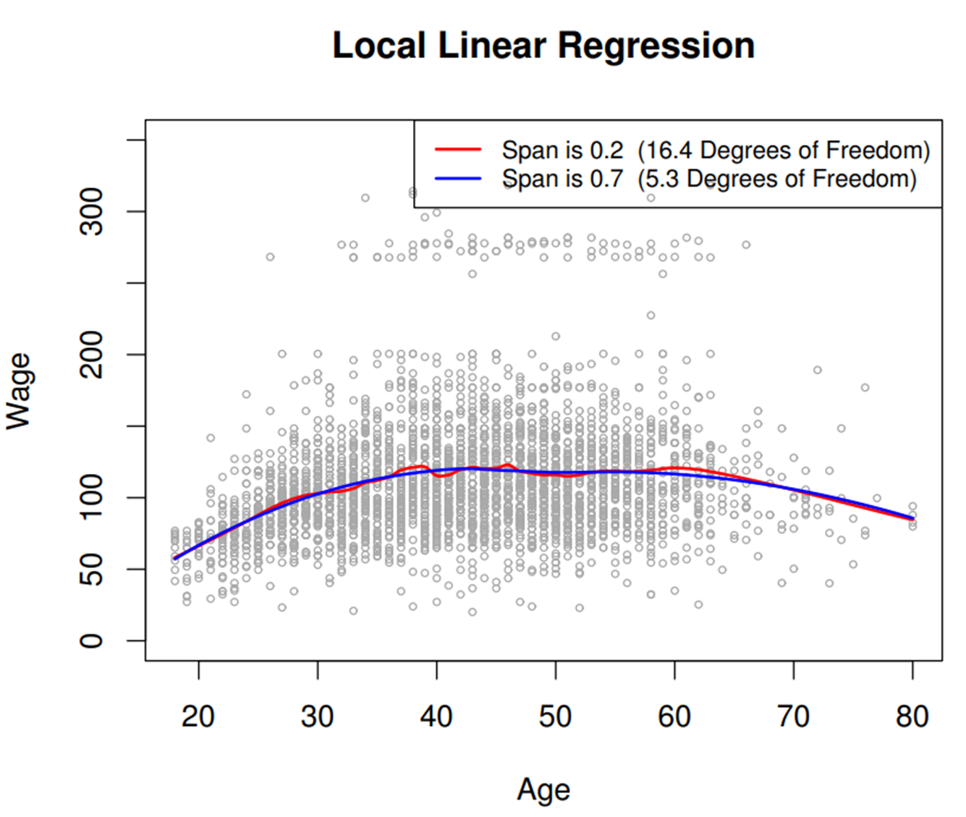
Local Regression
Notes:
Another approach for fitting flexible non-linear functions
It is a similar idea to k-nearest-neighbors (KNN)
It is a memory based procedure, so we must use all training data every time we compute a prediction
Tuning parameters
Window size (% subset of X values)
Smaller window size = less smooth fit
Larger window size = smoother, global fit
Weight for KNN

Slide 15
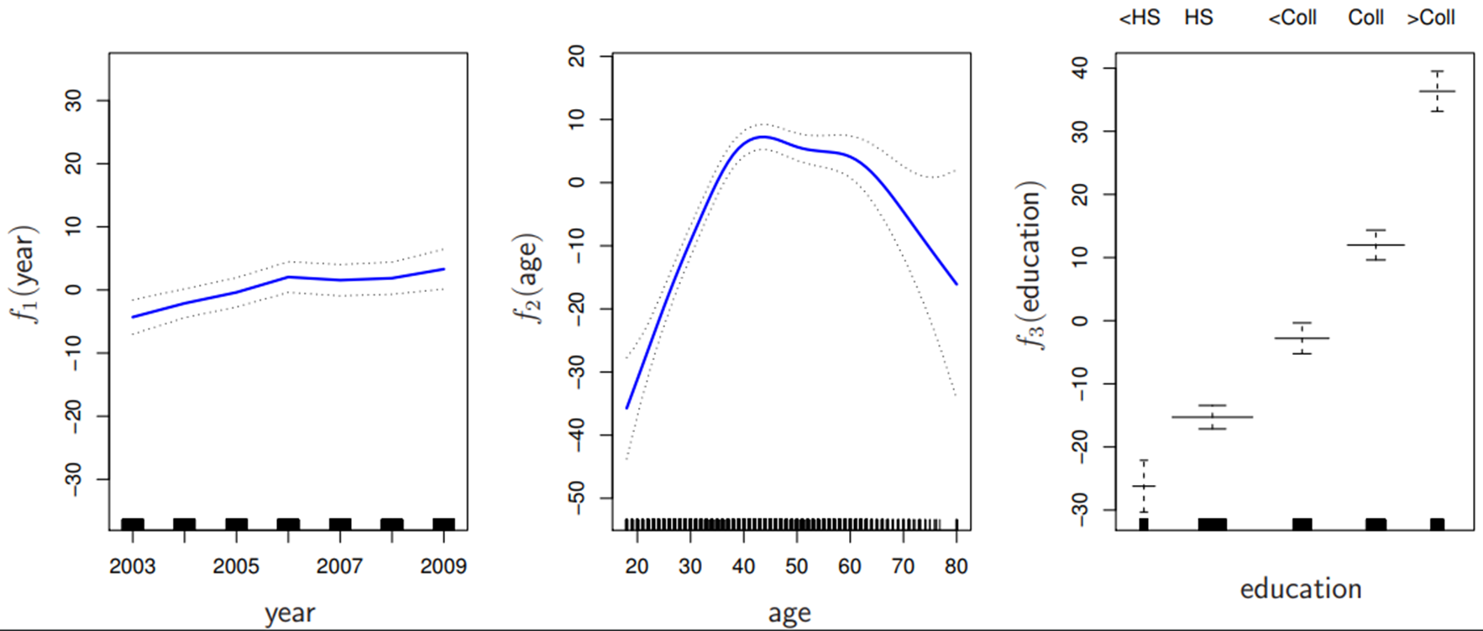
Generalized Additive Models (GAM)
Notes:
Provide a general framework for extending a standard linear model by allowing non-linear functions of each of the variables, while maintaining additivity
Can be used for both quantitative and qualitative Y variables
Because the model is additive, we can examine the effect of each X variable on Y individually while holding the other X variables constant
Smoothness of each function can be summarized by degrees of freedom
Main drawback is that the model can only be additive, so we could miss important interactions

Slide 16
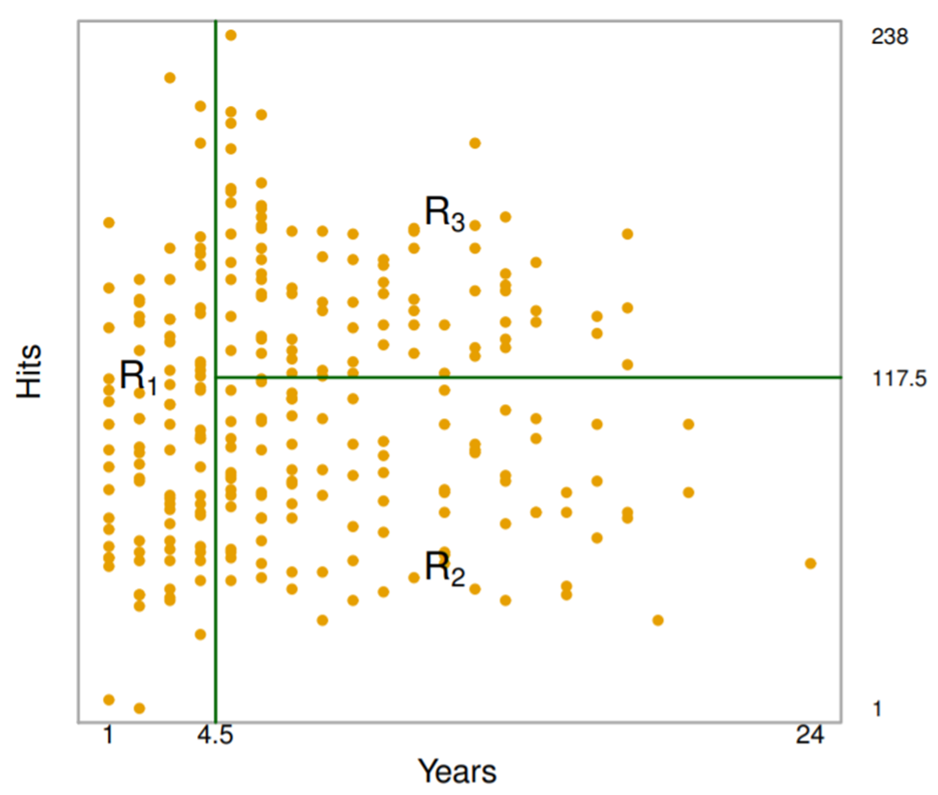
CH8.1 - Decision Trees
Notes:
Model describing how individual features affect the chance of a particular outcome
The objective is to improve purity
Split into subsets and see if they are pure (all Yes or No)
If Yes, stop; if No, repeat
Can use a regression tree or categorical tree depending on if Y is categorical or numeric

Slide 17

02
Code Review
Common functions used

Slide 18
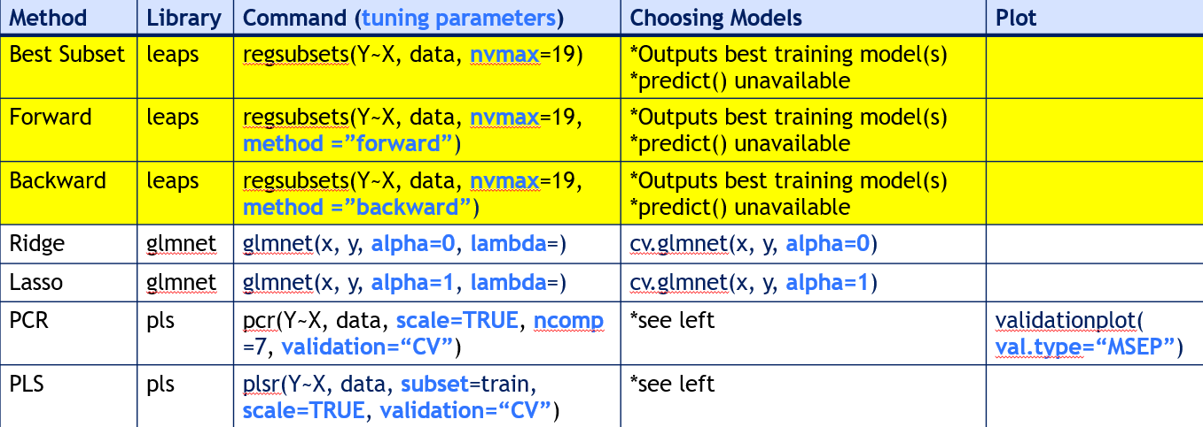
R commands for Feature Selection

Slide 19
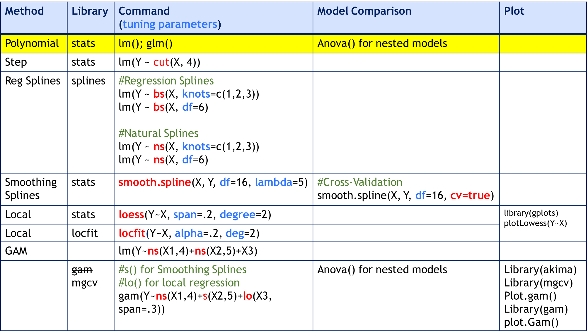
R commands for Non-Linear Models

Slide 20
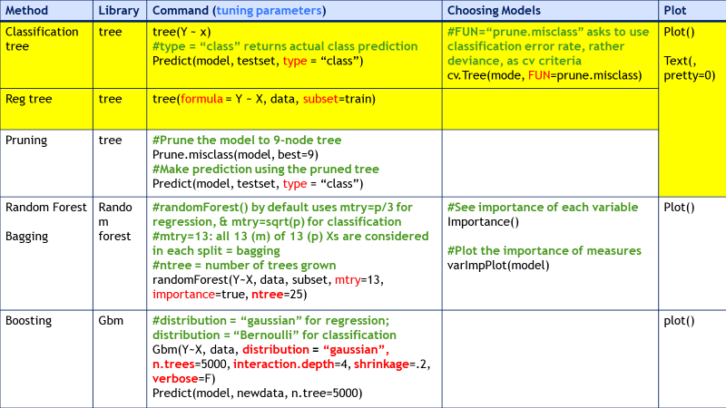
R commands for Tree Methods

Slide 21
Exercise
7.9
From Chapter 7

Slide 22
Kahoot Time!
https://create.kahoot.it/share/ml2-midterm-review/47b1db8a-35e8-416e-baaf-0b917a0af826

